Slide 1
ASP.NET Database Connectivity

Slide 2
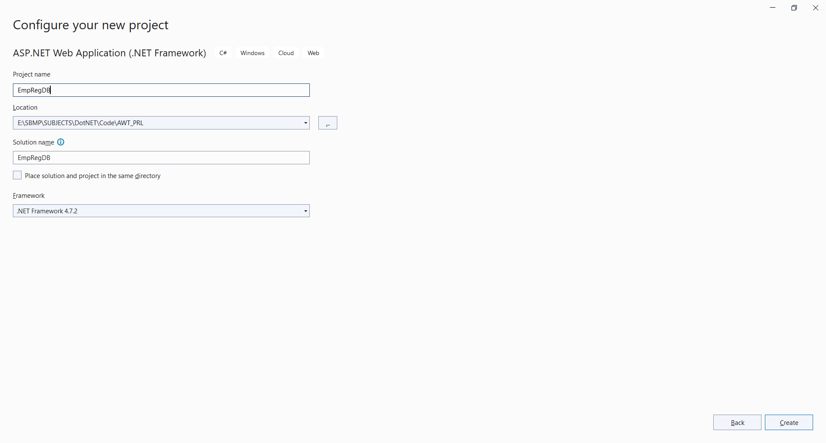

Slide 3
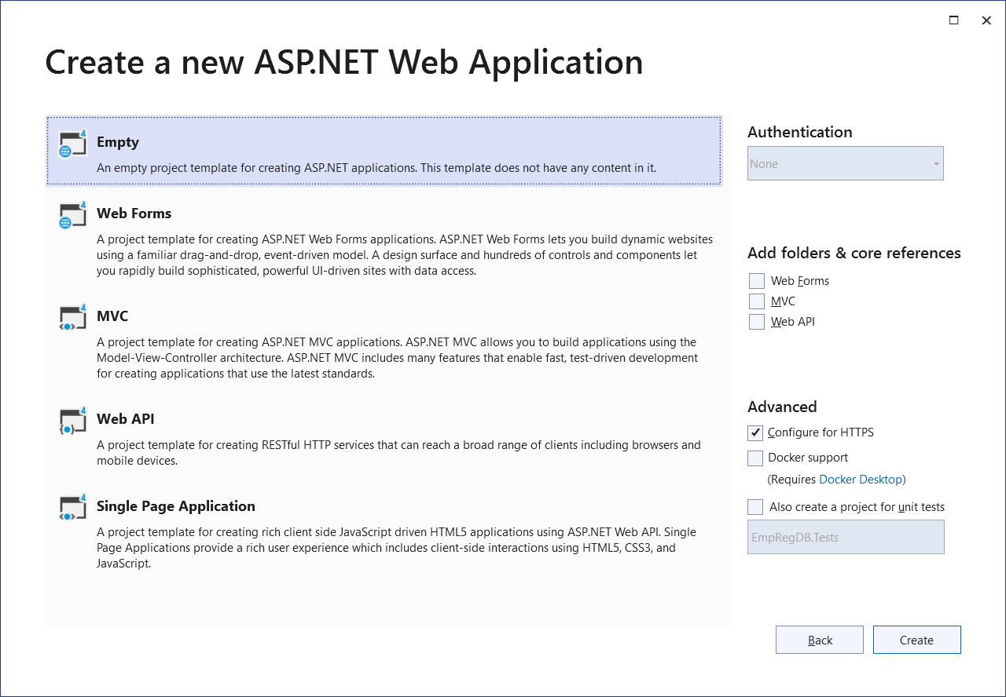

Slide 4
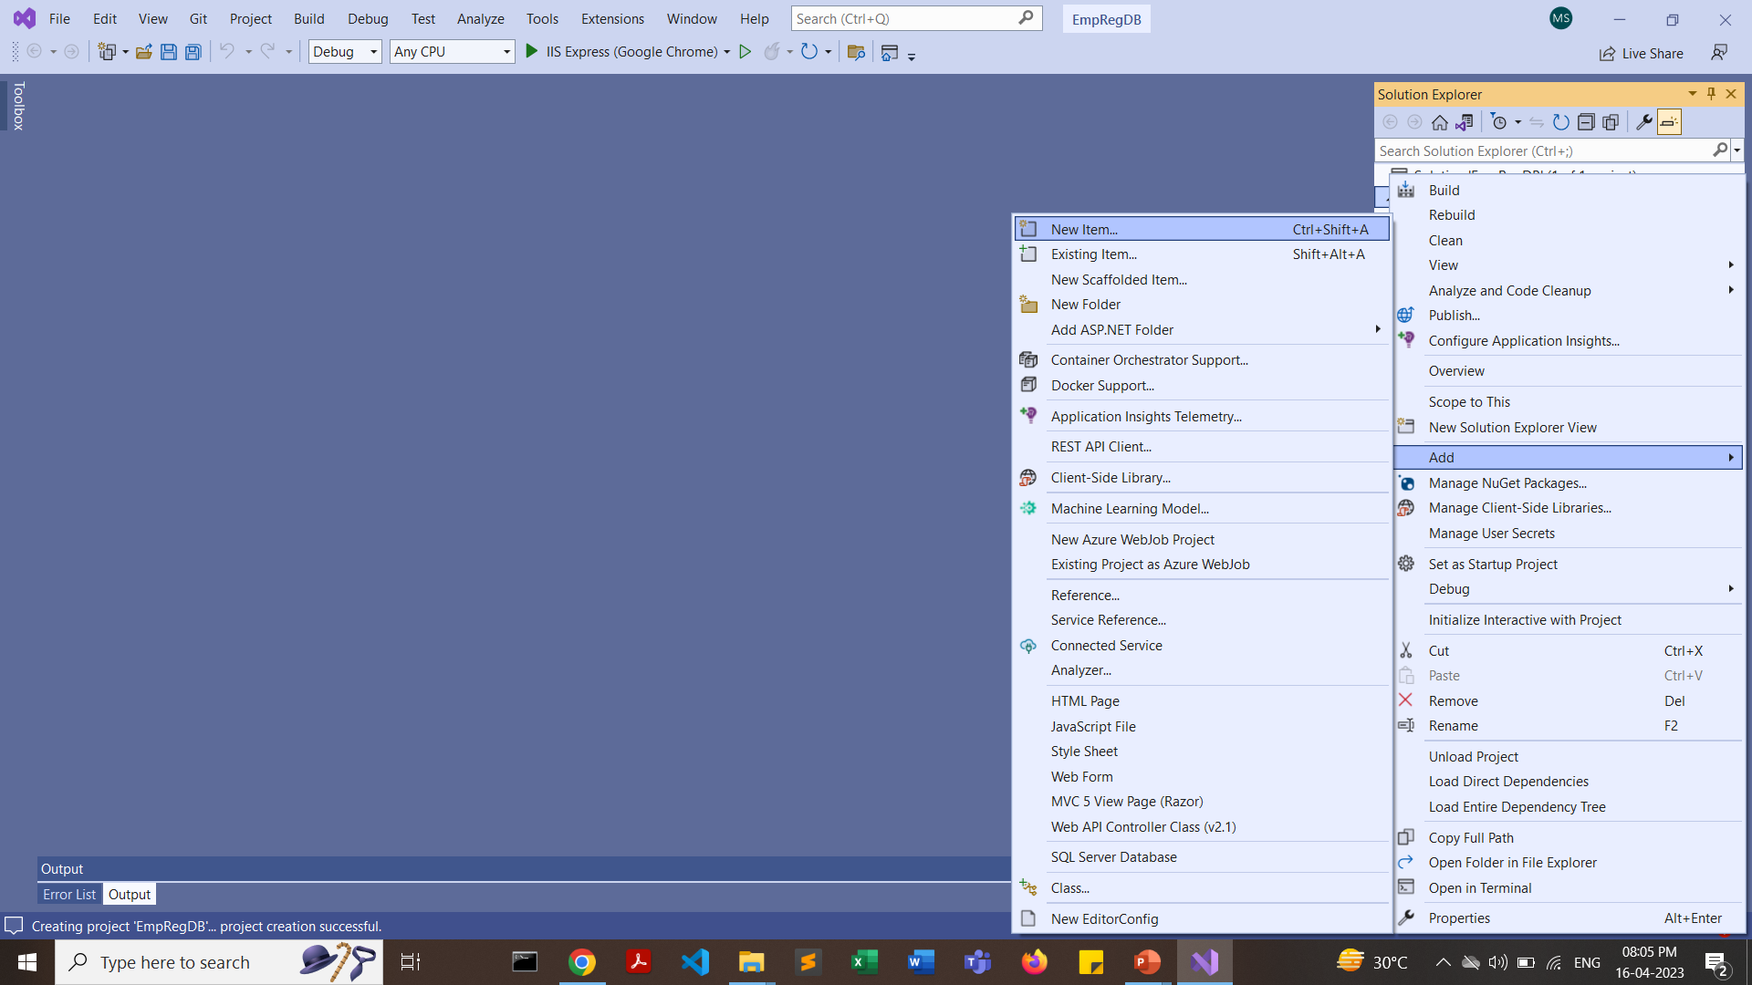

Slide 5
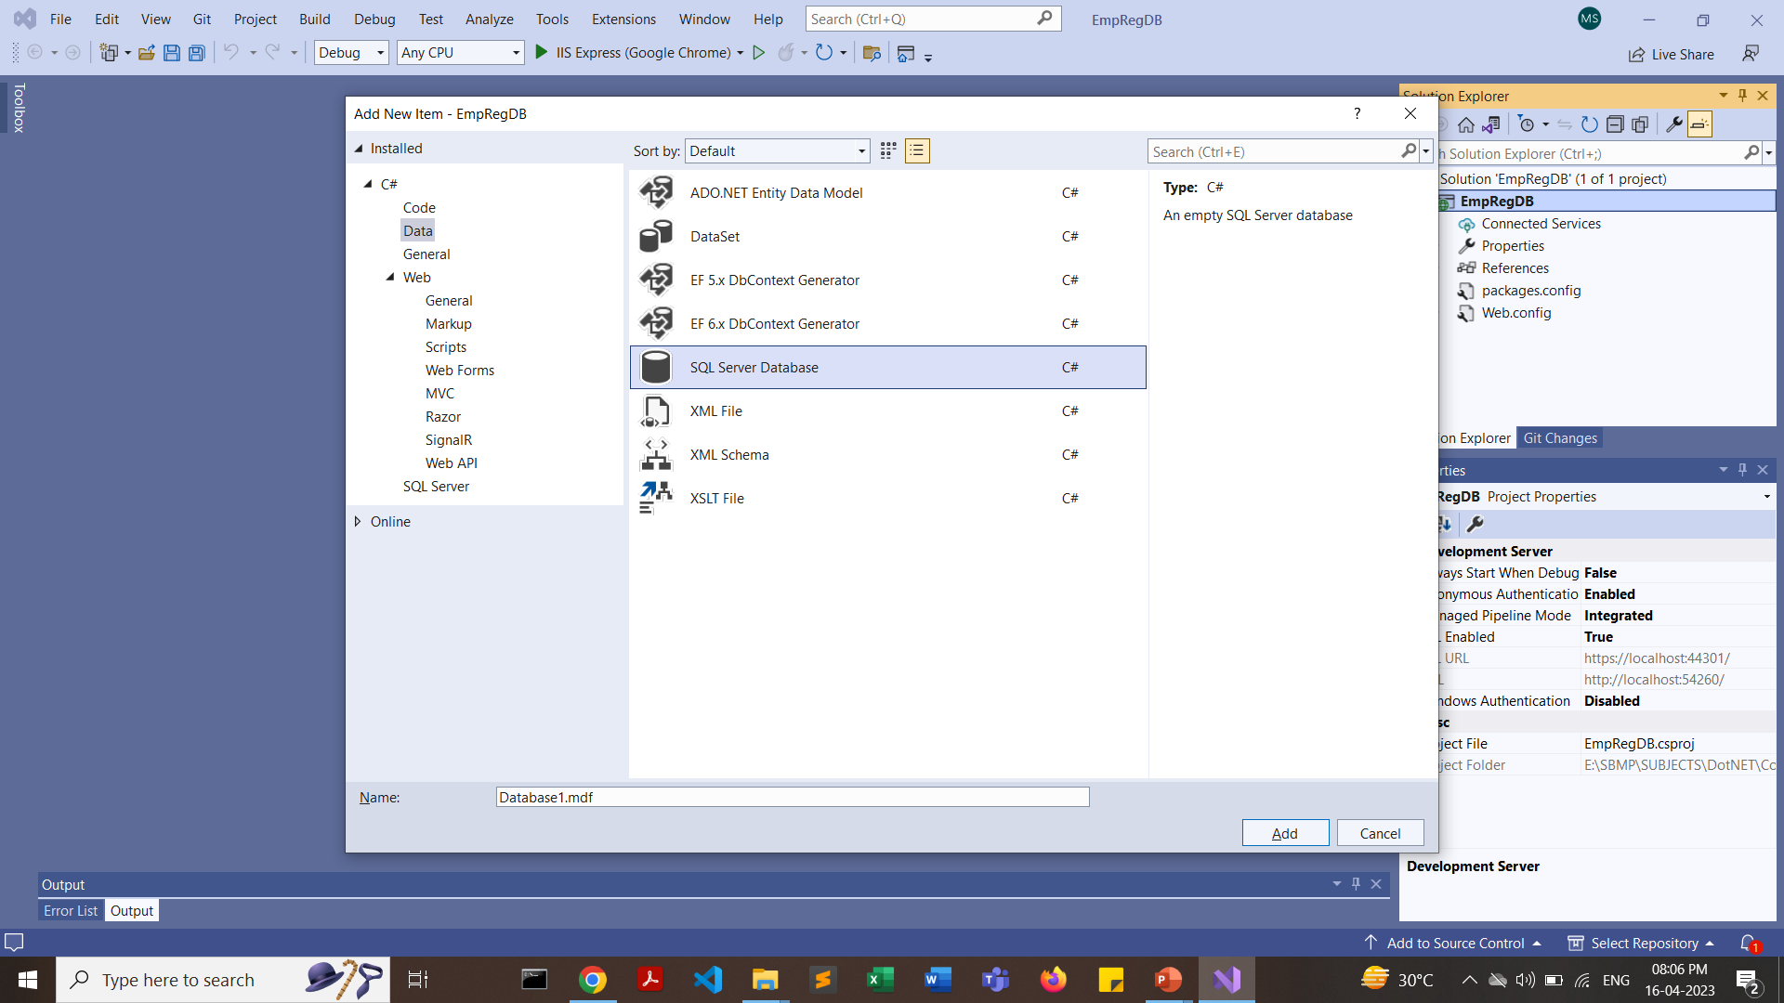

Slide 6
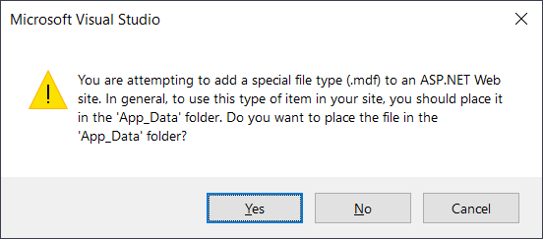

Slide 7
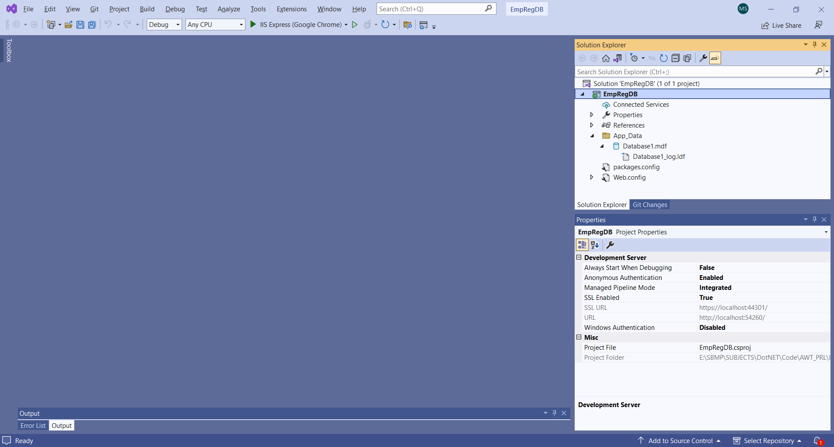

Slide 8
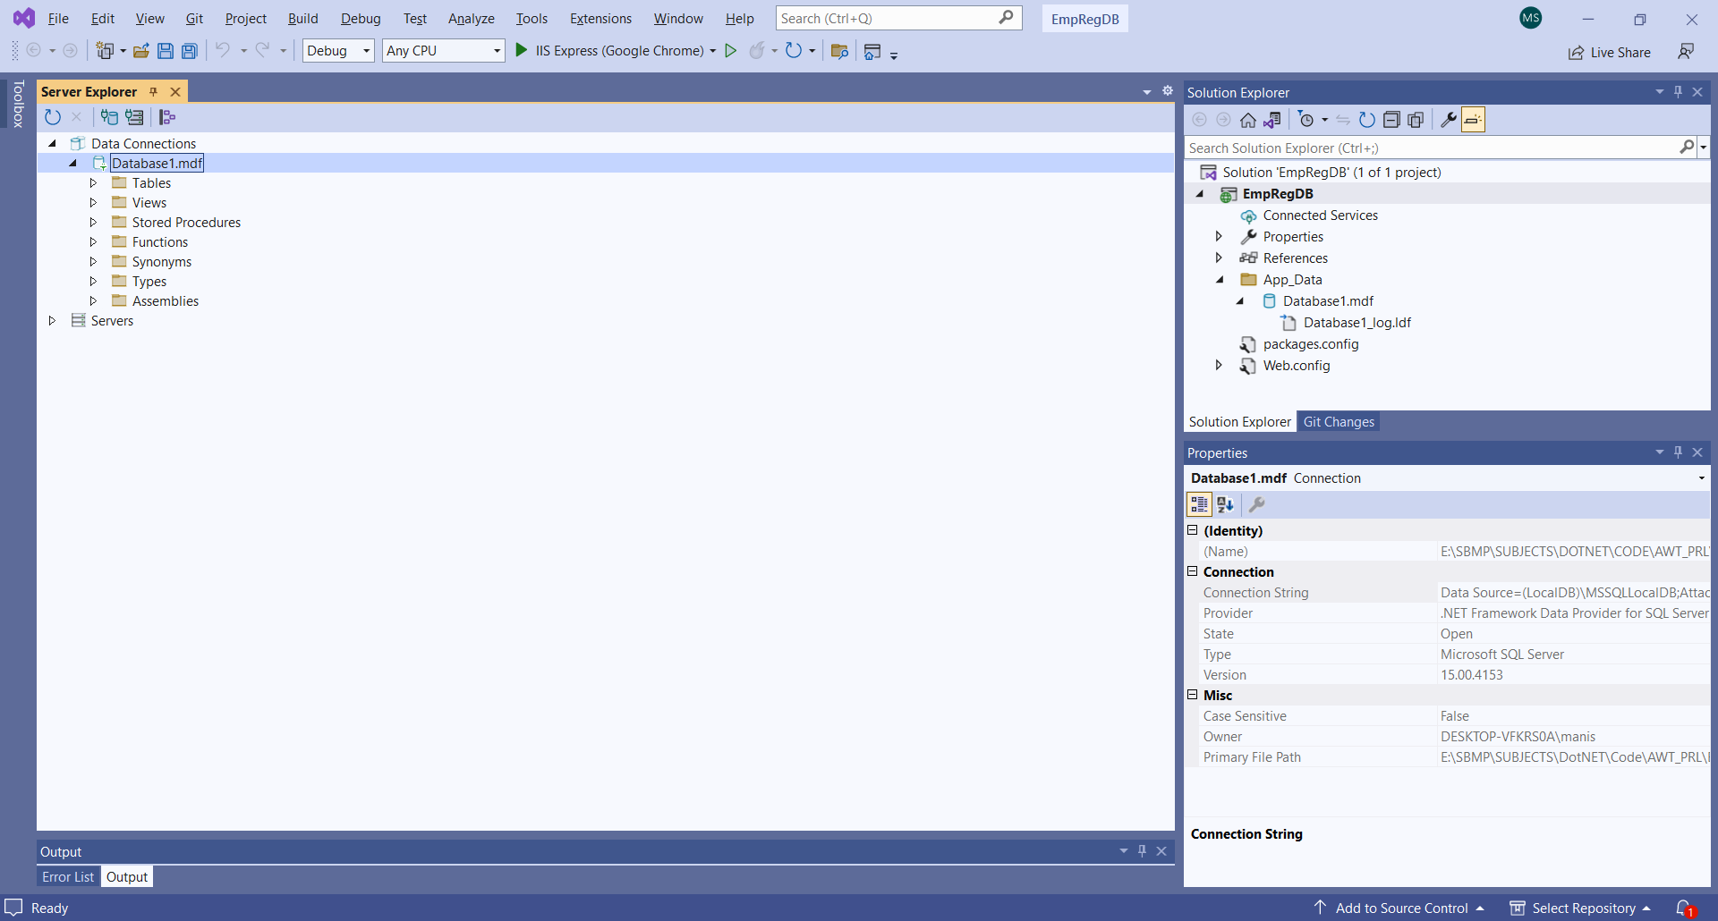
Right Click on “Tables” and click “Add New Table”

Slide 9
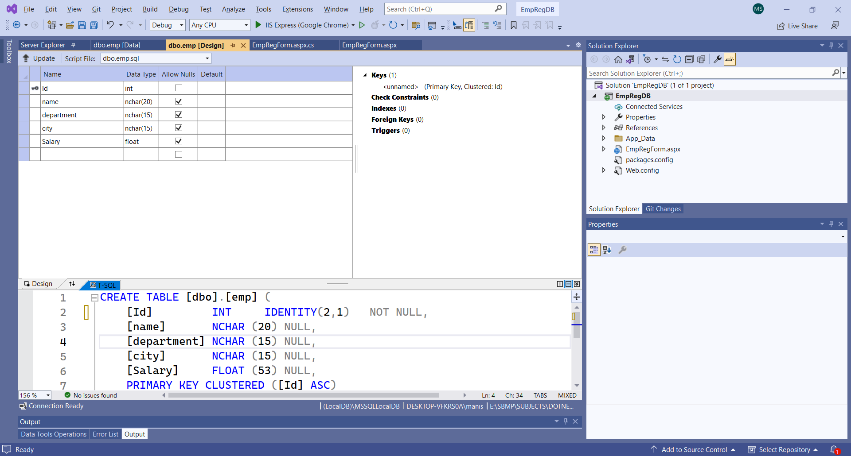
Click on “Update” button
To set a column auto increment use IDENTITY(1,1) as I have already inserted 1 row with id 1, I have started with 2

Slide 10
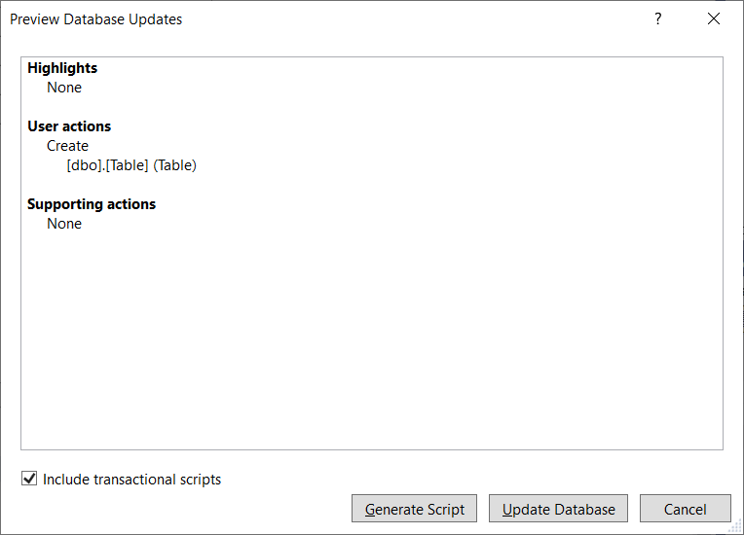
Click on “Update Database” button

Slide 11
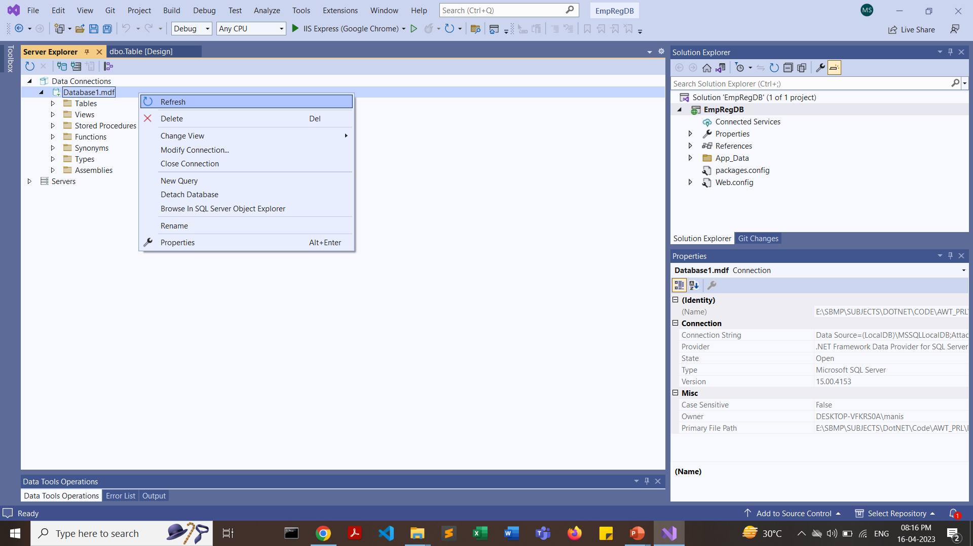
In Server Explorer, right click on Database1.mdf and click on Refresh

Slide 12
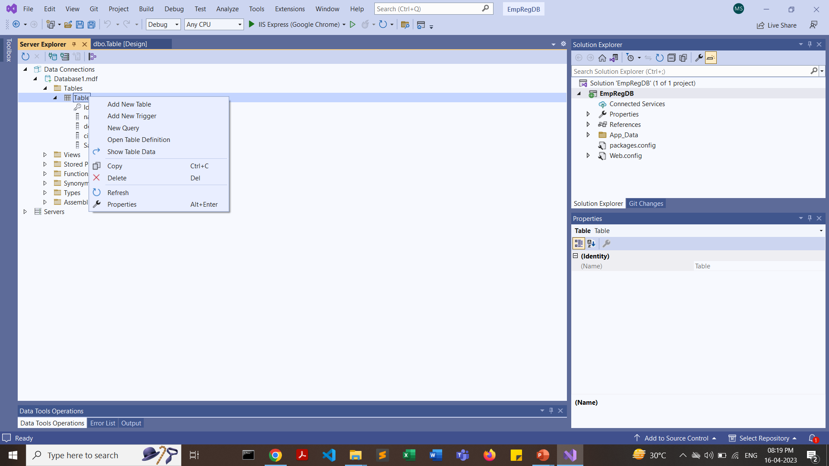

Slide 13
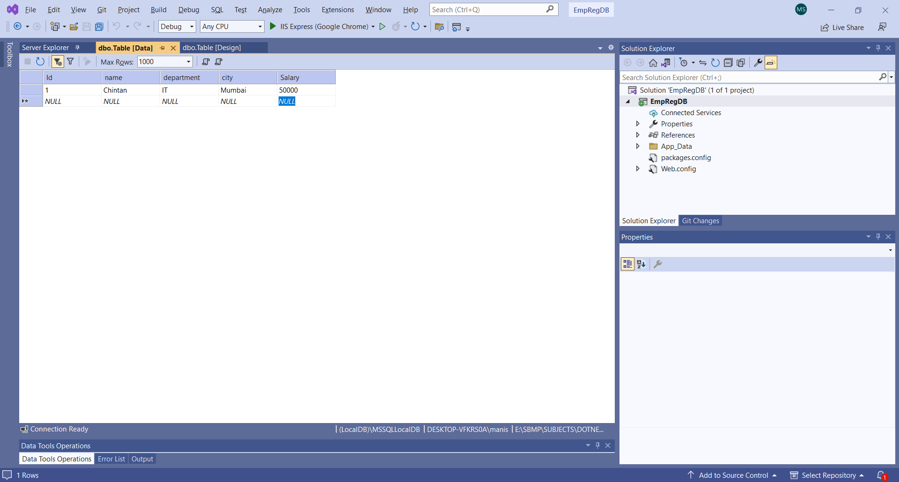

Slide 14
Create a Registration Form

Slide 15
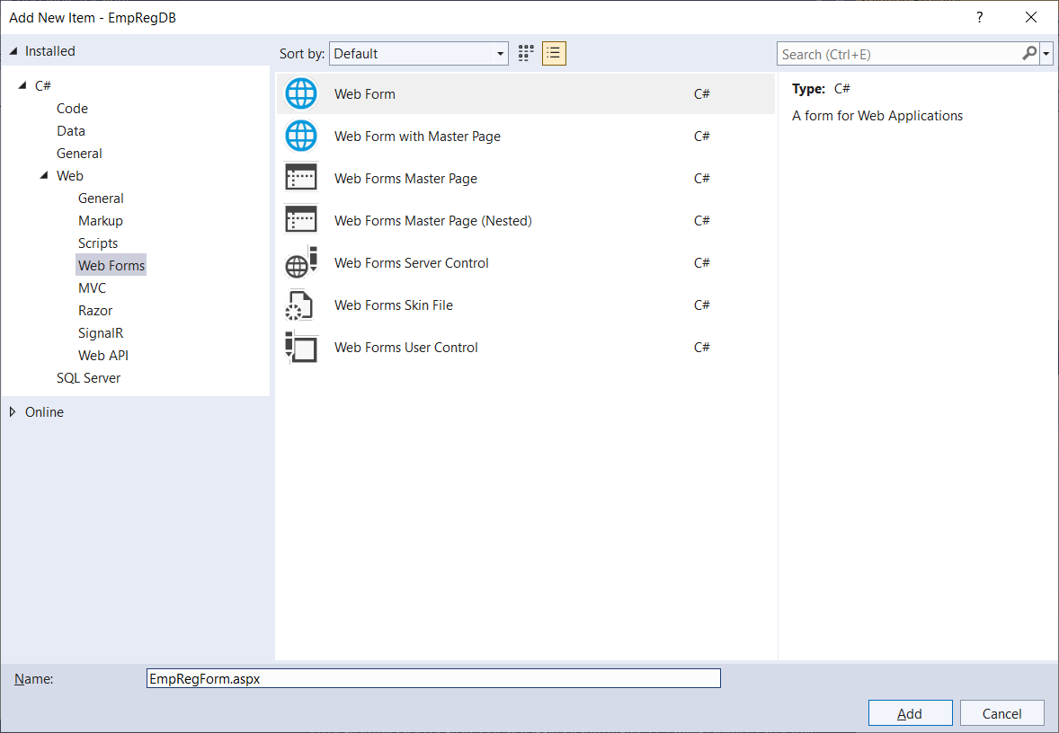

Slide 16
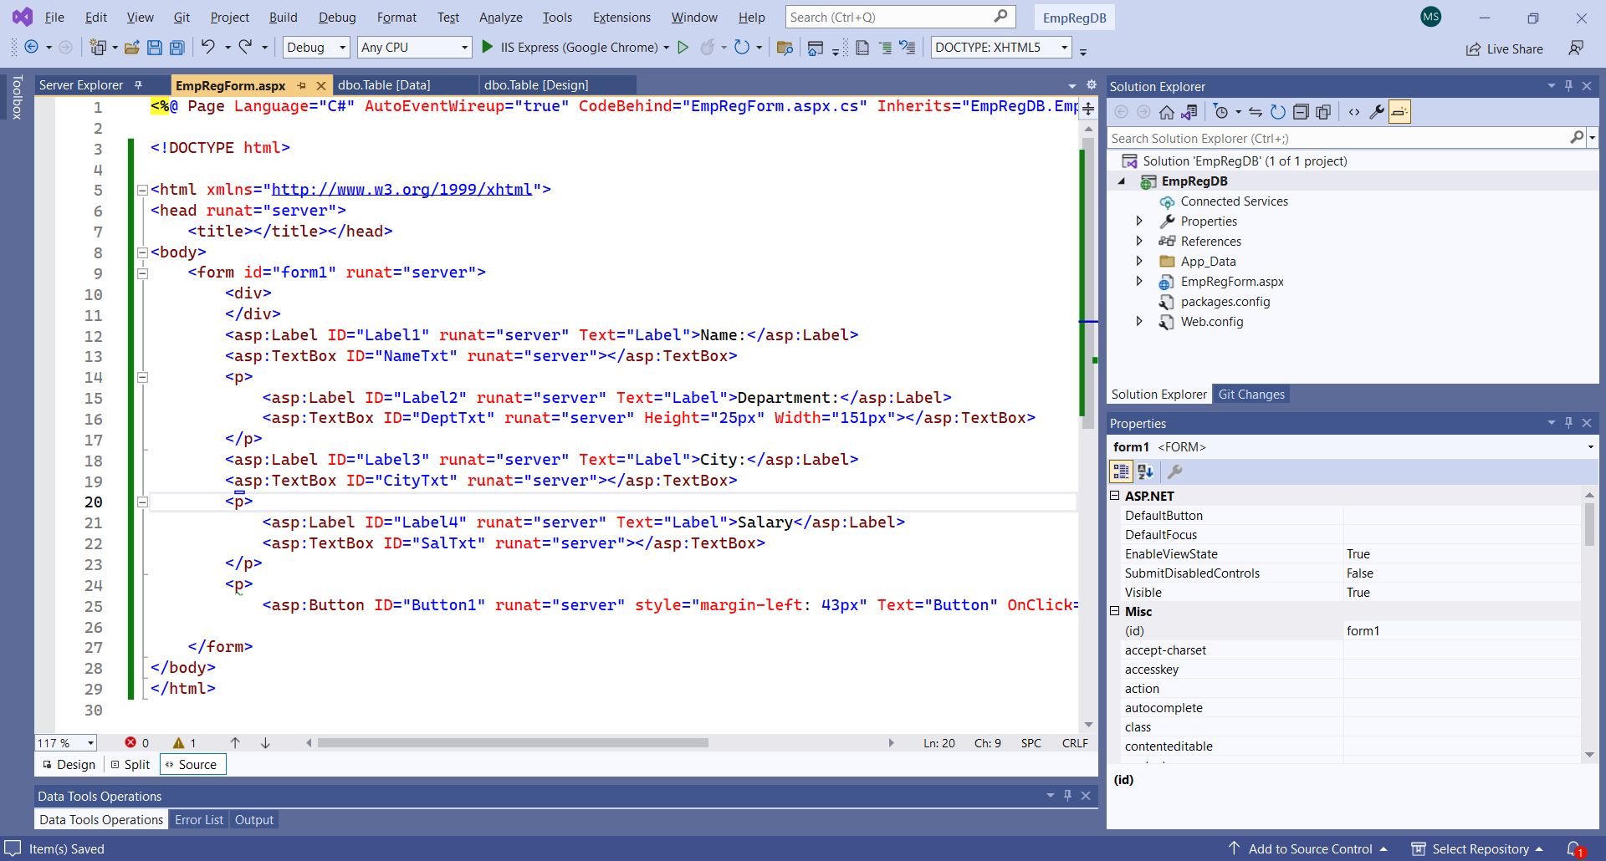

Slide 17
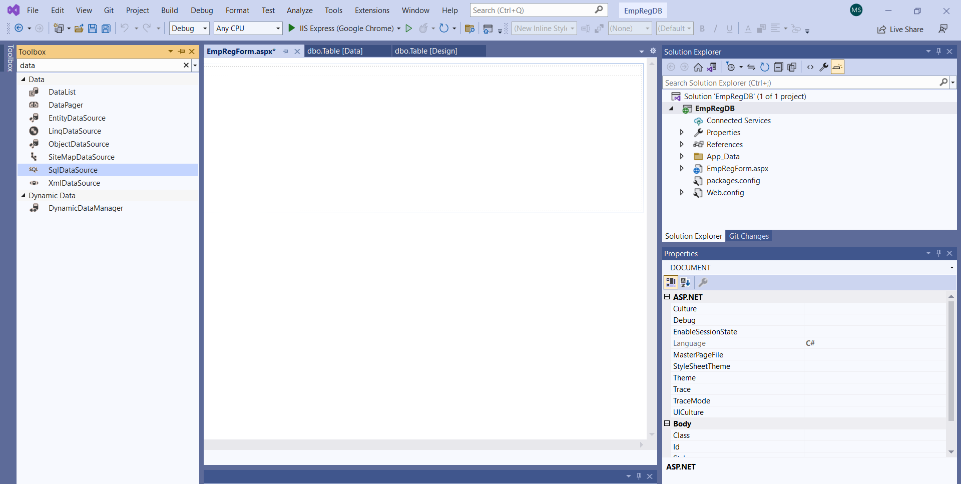
From ToolBox search “SqlDataSource” and double click on it. DataSource Control will be added in the form

Slide 18
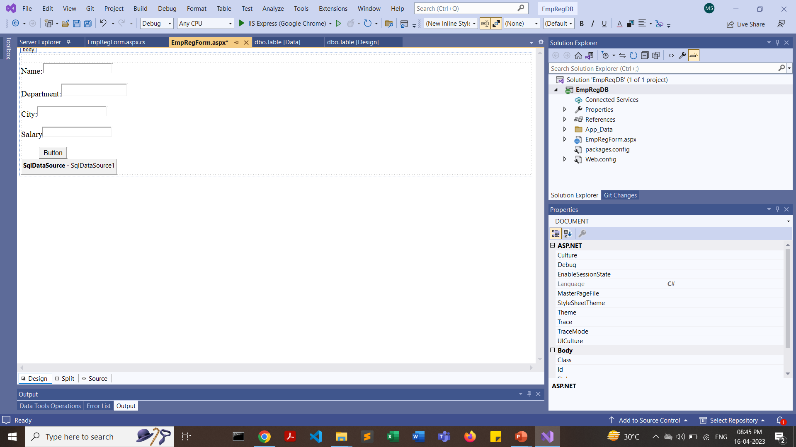

Slide 19
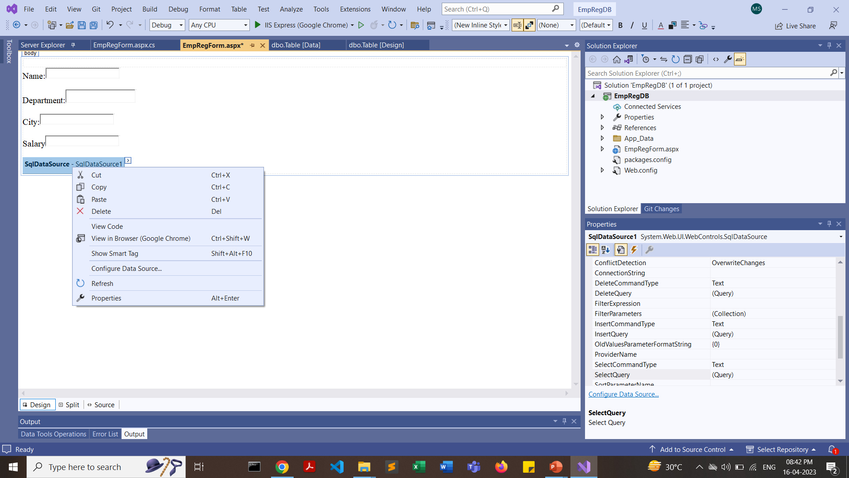
Right Click on SqlDatSource and select “Configure Data Source”

Slide 20
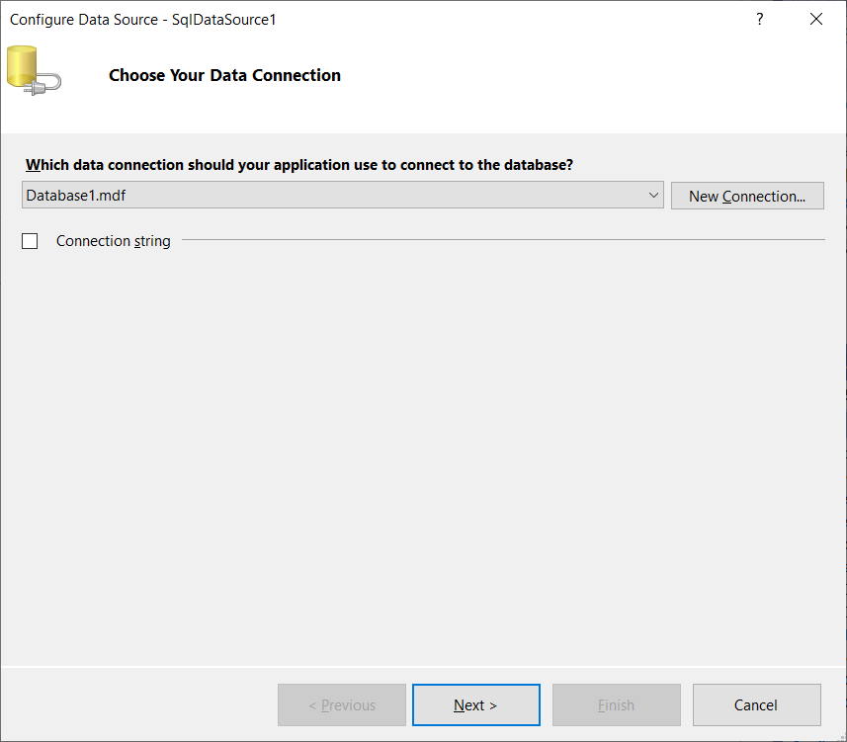
Click on DropDown and select the database name

Slide 21
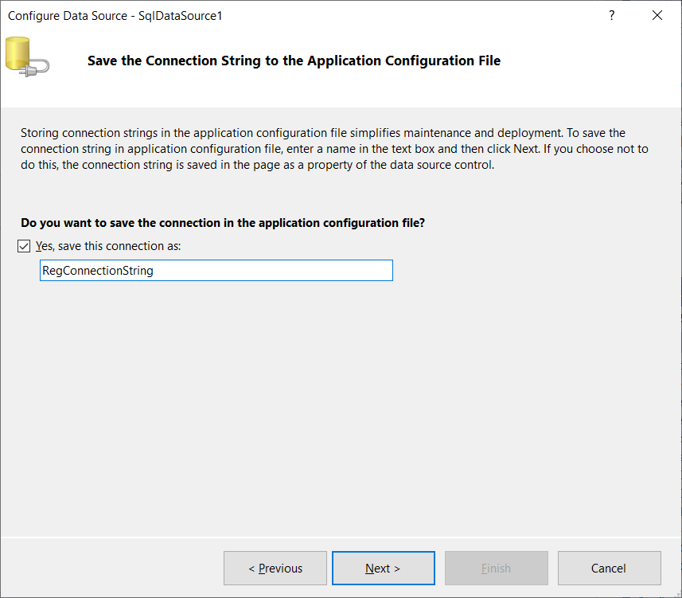

Slide 22
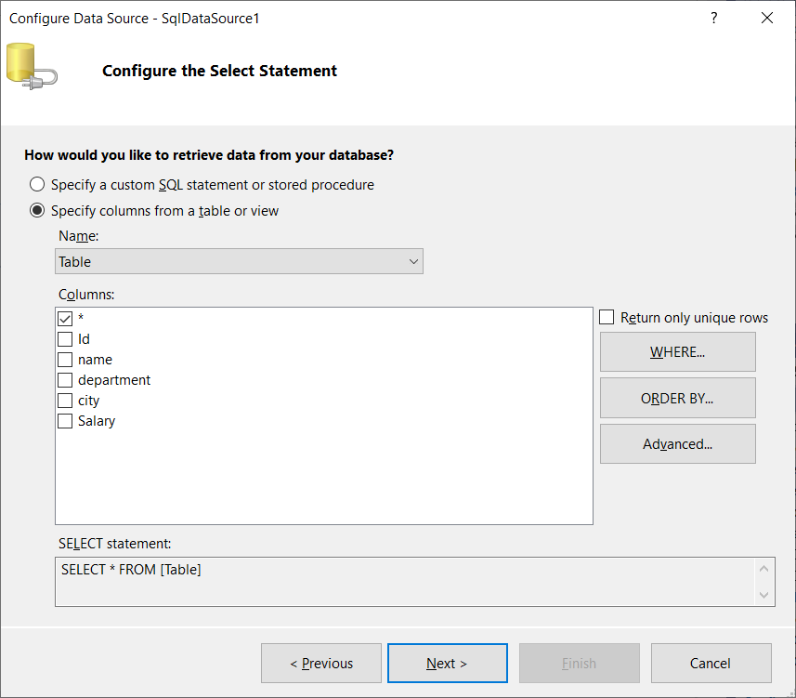

Slide 23
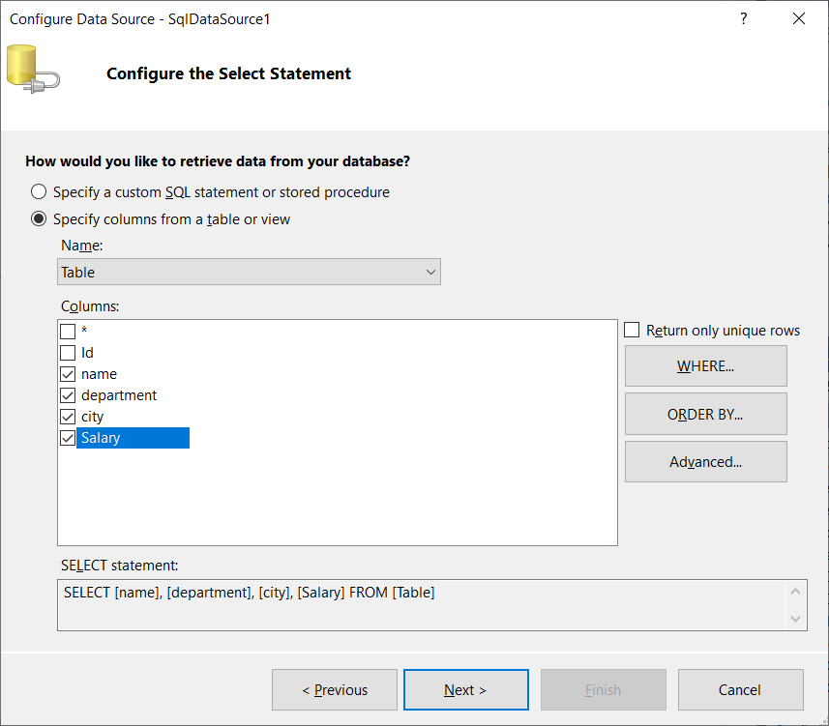
Select the table fields

Slide 24
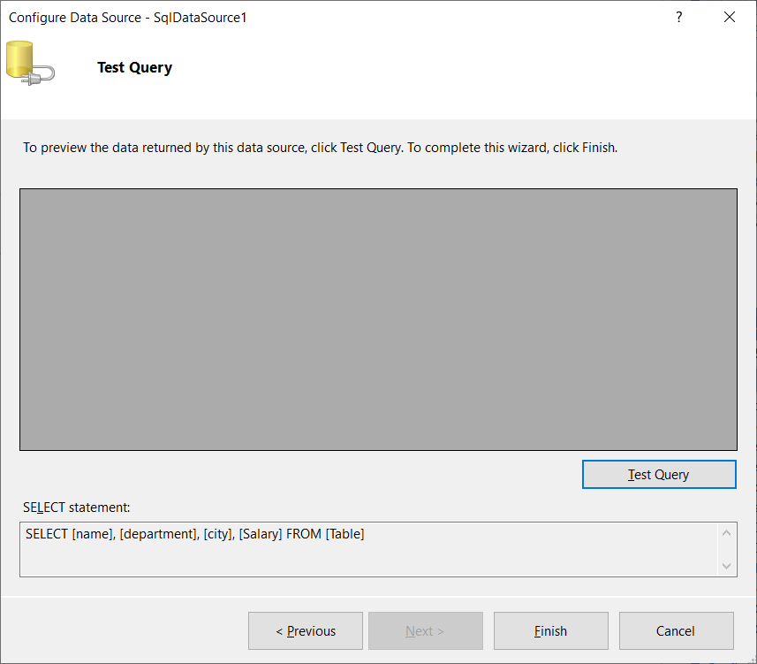
Click on “Test Query”

Slide 25
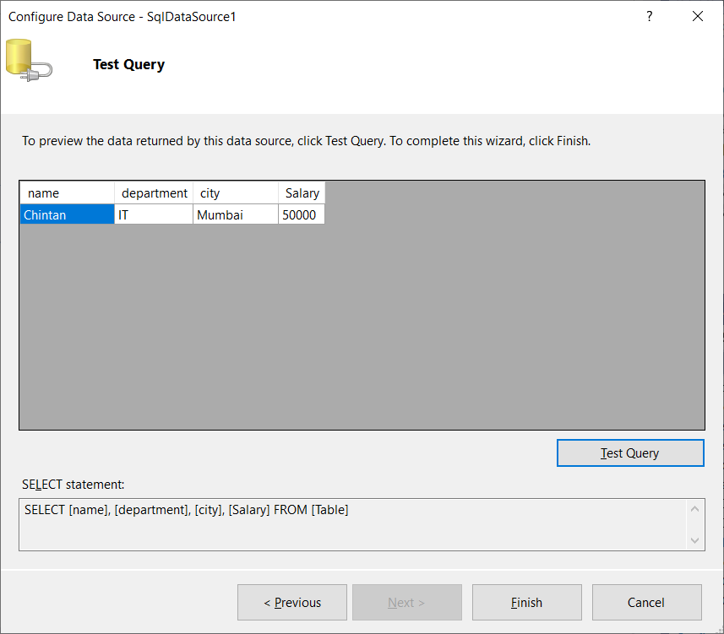

Slide 26
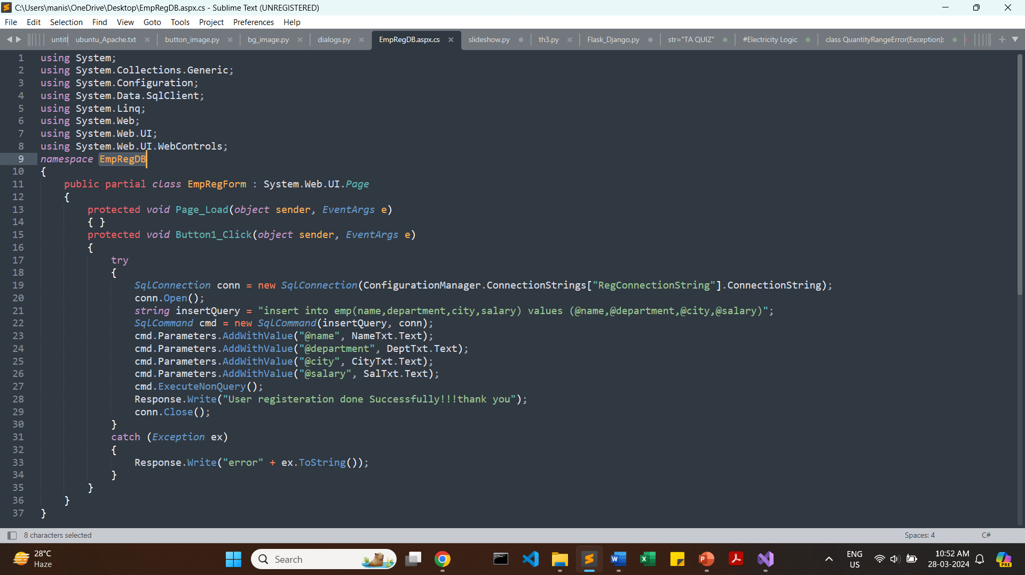
EmpRegForm.aspx.cs

Slide 27
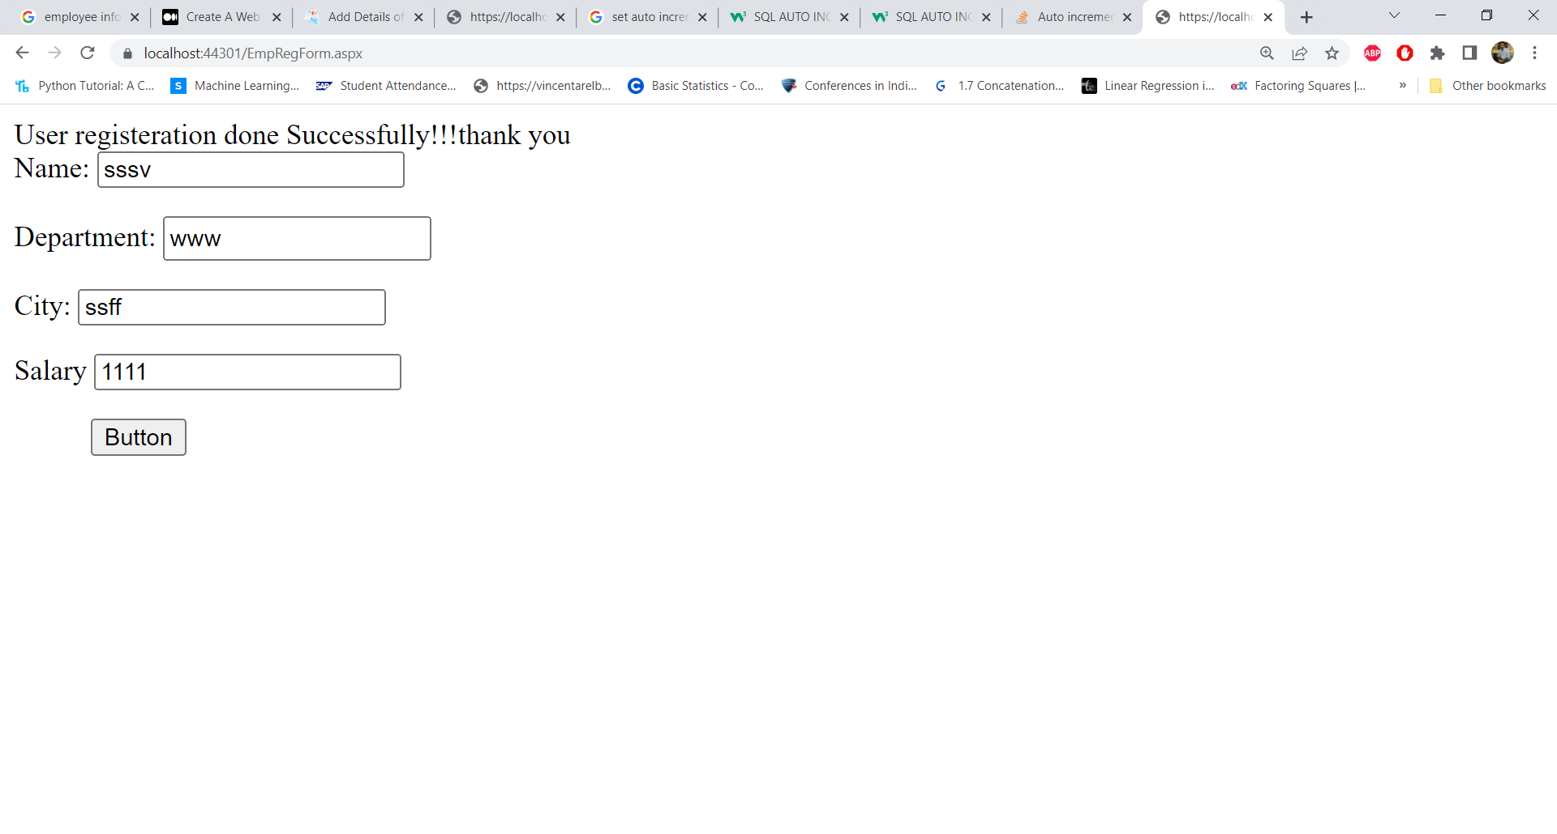

Slide 28
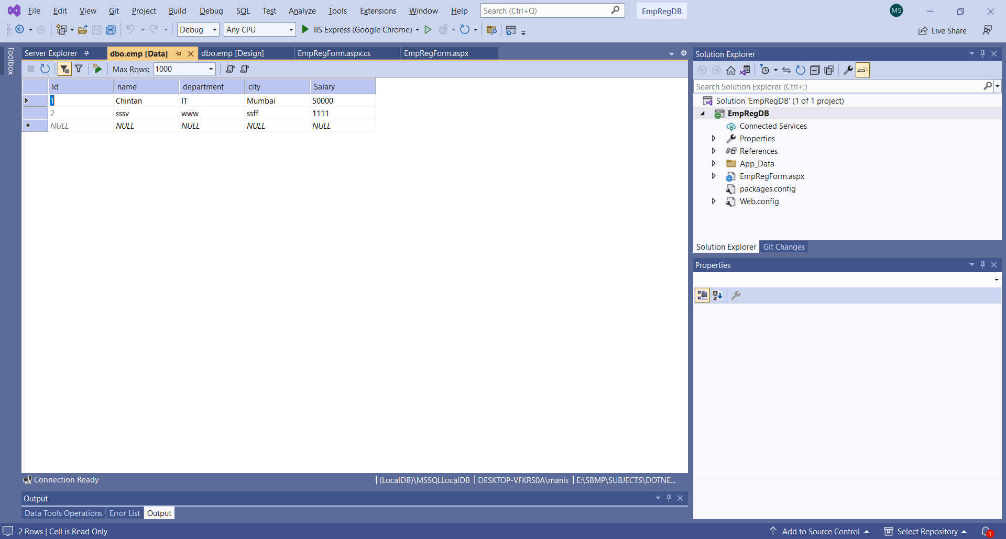

Slide 29
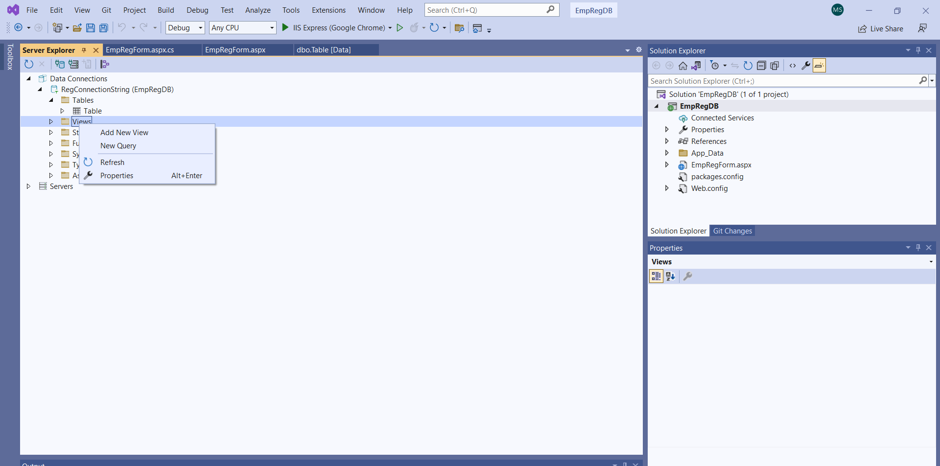
To rename the table name: Inside Server Explorer, right click on “Views” and click on “New Query”

Slide 30
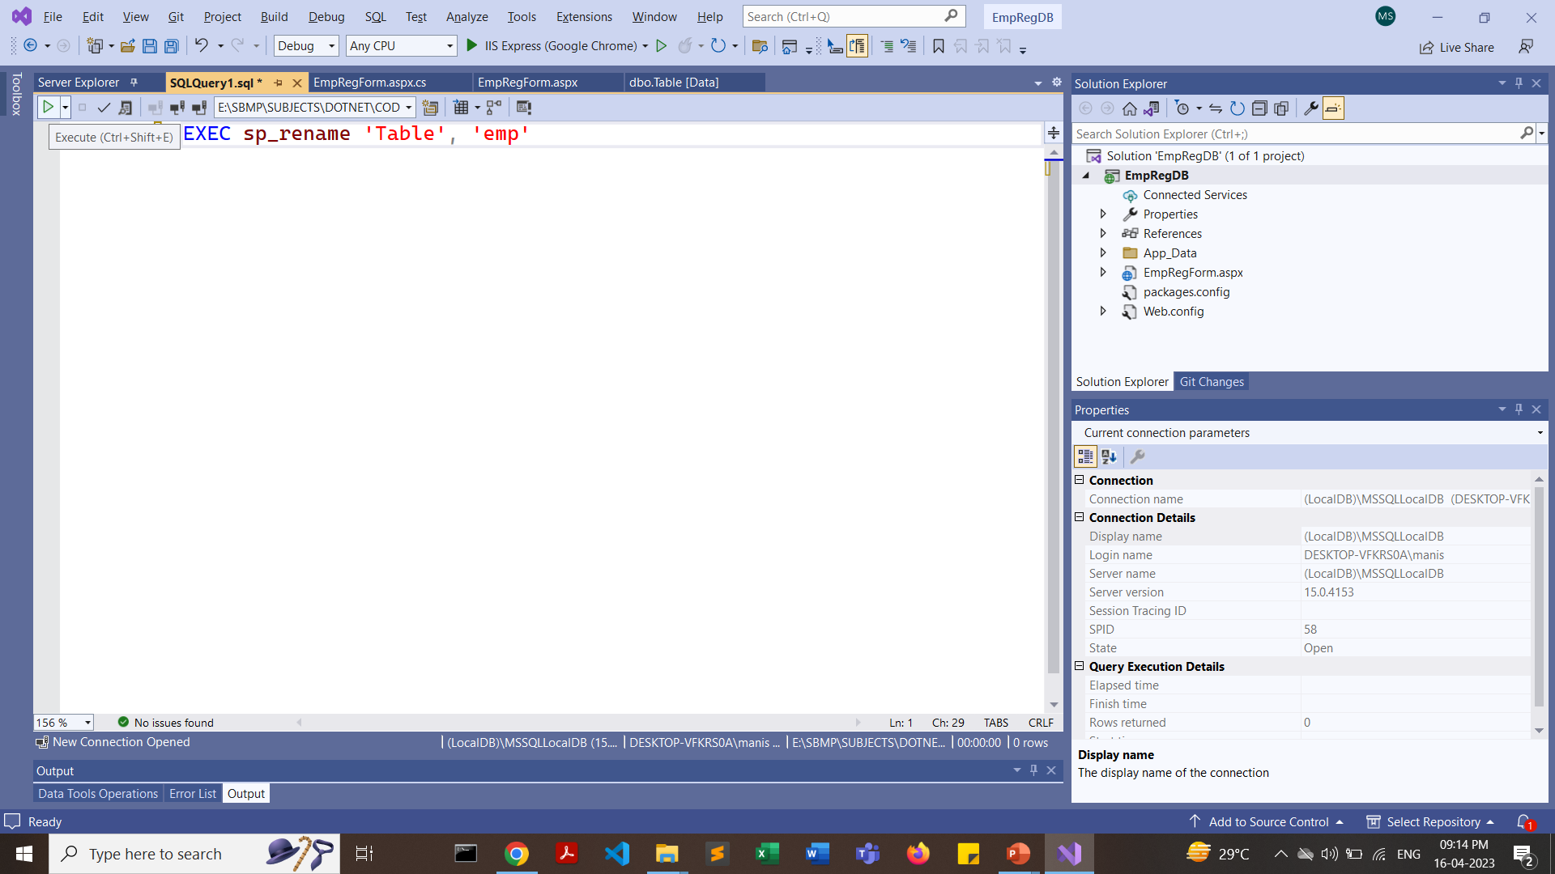
Click on “Run” button

Slide 31
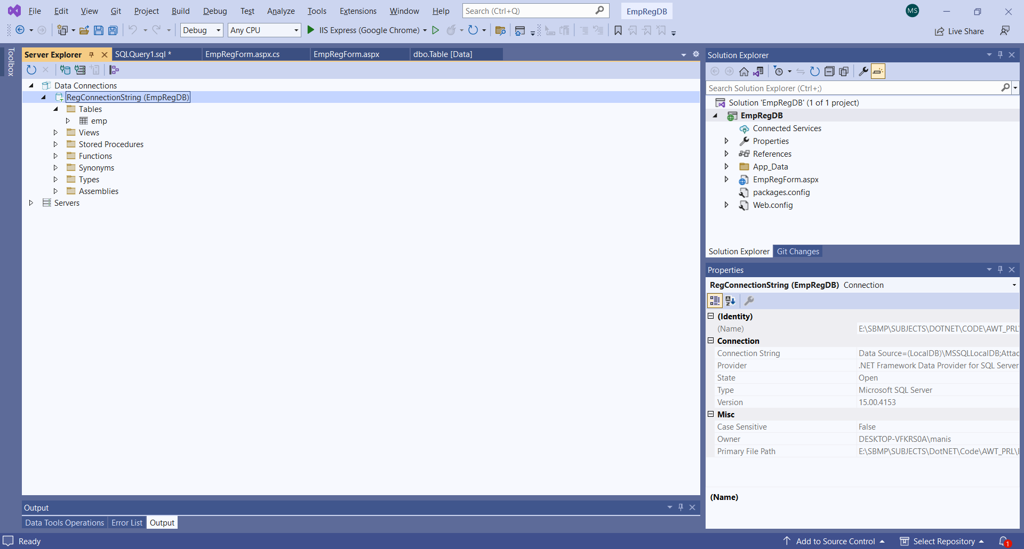
Refresh the RegConncetionString

Slide 32
https://stackoverflow.com/questions/20538880/how-to-change-the-table-name-in-visual-studio-2013-in-design-mode

